Slide 1
The Effect of Parenting at a Young Age and the Parenting Style of the Parent
Keyrsten Knight
Salt Lake Community College
PSY 1100 - 016
04/15/2013

Slide 2
Stress and Over Reactive Parents
High levels of stress have been shown to result in the use of over reactivity in the discipline practices of the parents. Over reactivity is a characteristic authoritarian parenting style.

Slide 3
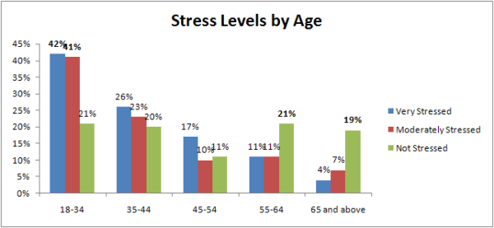
Levels of Stress by Age between 2011 and 2012

Slide 4
Adult Drug Use and Parenting
Adults are more likely to develop habits involving illicit s substances during the emerging adult years.
Drug use has been found to increase the possibility of premarital pregnancy.
Parents who use drugs are likely to be less involved in the lives of their children. These parents are more likely to present characteristics of a neglectful parenting style.

Slide 5
References
Prinzie. P, Onghene. P,and Hellinckx. W., (2007). Reexamining the Parenting Scale. European Journal of Psychological Assessment 2007; Vol. 23(1): 24-31 DOI 10.1027/1015-5759.23.1.24
Kandal. D. B. (1990). Parenting Styles, Drug Use, and Children’s Adjustment in Families of Young Adults. Journal of Marriage and the Family 5S (February 1990): 183-196.
Semans, D. (2012). Marketing Research Shows Young Adults Have the Most Stress. Chart Found at: http://www.polarismr.com/POV/bid/82187/Marketing-Research-Shows-Younger- Adults-Have-Most-Stress

